Slide 1

PyTravel
Frank Lau
Monique Ferguson
Marcela Castaño

Slide 2

Motivation
Early on, we decided we wanted to integrate data from free APIs into our project.
We explored a couple different sources and settled on using available APIs on RapidAPI.com
Travel data sparked our attention the most
“There’s lots we can analyze here” we thought to ourselves, and we were right!
There will be lots of puns arriving soon, but we are experiencing some delays.
We found dedicated APIs for flights, hotels, car rentals, parks & trails, points of interest, etc.

Slide 3
Objectives
All-in-one travel planner powered by FinTech
Estimate travel budget, find out travel restrictions at intended destination, and survey hotel reviews
Learn more about the tourism industry

Slide 4
A Solution…Trichotomy?
How do we generate a travel itinerary?
We started out with the idea of “selling an experience”. Our plan was to provide a full vacation package for imaginary customers using API data. This plan was ambitious, and so, in the end, we narrowed it down to provide flight and hotel quotes for a single customer.
Which travel destinations should we consider?
The idea of generating a travel package quickly led us to consider current travel restrictions due to COVID-19. We decided it was imperative we shared a summary of these restrictions to our imaginary customer.

Slide 5
A Solution…Trichotomy?
What do we know about the tourism industry?
At some point, we found statistics on tourism worldwide. This seemed like an interesting dataset that we could incorporate into our project.
This is when we decided that our travel agency was interested in analyzing customer-focused data and agency-focused (or internal) data.

Slide 6
Questions
Tourism and Travel
How has worldwide travel progressed over the years?
Data from https://data.worldbank.org/indicator/ST.INT.ARVL
From geopy.geocoders we imported Nominatim to retrieve latitude and longitude
Which Continents Are The Most Travelled To?
Data from https://data.worldbank.org/indicator/ST.INT.ARVL
From geopy.geocoders we imported Nominatim to retrieve latitude and longitude
How did COVID-19 affect the rate of travel in the USA?
Data from https://www.tsa.gov/coronavirus/passenger-throughput
Where do sharks go when they want a vacation? Finland.

Slide 7
Questions
COVID-19 Travel Restrictions
How has COVID-19 affected international travel from the United States?
Data set + relevant library or API
What are some of the travel restrictions that have been implemented due to COVID-19?
Data set + relevant library or API
Do you know why many people love going to South Korea? To find their Seoul mates.

Slide 8
Questions
Travel Planner
What are the flight options available for the client's intended destination?
Skyscanner API endpoint @browse quotes to obtain Airline and Price data
What is the hotel availability in the destination of interest?
Booking.com API endpoint @Search locations to return number of hotels in 5 areas(e.g. districts) in the city of choice.
Czechs do not have time to waste. They are very Prague-matic.

Slide 9
Questions
What are some of the hotel options? How do these compare to each other in price and quality?
Booking.com API endpoint @Search hotels to return hotel prices, reviews, physical address, etc. in the area of choice. This requires a destination_id obtained with @Search locations endpoint.
How can we compare hotel locations with other points of reference?
Folium Library to generate an interactive map with icons for each hotel
I’d like to know why the winters are so cold in America. I think Alaska local.

Slide 10
Data Cleanup and Exploration
Tourism and Travel
For information on international tourism travel, we downloaded data from worldbank.org. This data set included the number of arrivals per year for each country up to 2019.
Then we used geopy to append the latitude and longitude of each country into the data frame. Again, we used a for loop for this.
The latitude and longitude columns were moved from the end of the column list. They were placed after the countries but before the year 1995.
The melt function was used to unpivot the data frame from wide format to long format. Afterward, there was only one column that contained year values.
From this data, we inferred that international travel has generally increased each year. However, there were slight dips in 2003 and 2009, which could be due to the Iraq war and the recession of 2008.
The scatter geo and bar chart showed how the number of arrivals changed each year. The pie chart shows the percentage of visitors to each continent.
For USA-specific information, we imported a TSA chart (https://www.tsa.gov/coronavirus/passenger-throughput), and the nulls were dropped. In addition, a line chart was produced which showed that in 2020 visitor travel plummeted compared to the 2019 year.

Slide 11
Data Cleanup and Exploration
Covid-19 Travel Restrictions
In order to create the interactive map, we needed data on travel restrictions. In order to do this, we manually scraped data from https://www.kayak.com/travel-restrictions into a dataset called covidrestrictions.csv. This csv file contains Country information, A3 Codes, X and Y coordinates, COVID-19 travel requirements, and population vaccination percentages.
Regarding the interactive map, we decided to use the package Geopandas and the python library Bokeh. These packages use polygon based shapes to form boundaries and layouts of different maps. Because we are creating a global map, we downloaded and utilized large scale cultural vectors provided from https://www.naturalearthdata.com/downloads/10m-cultural-vectors/.
After requiring the two sets of data needed, we merged covidrestrictions.csv with the shape data. Using the merged dataframe, we proceeded to use bokeh functions to create and customize the interactive map.
To optimize the merged data, we needed to explode the dataframe to convert multipolygons to polygons in order to avoid country boundary overlap.
After customizing and prepping the plot, we finalized the plot by exporting it as an html. Hovering over individual countries will show the country name, status, restrictions, and population vaccination percentages if available.

Slide 12
Data Cleanup and Exploration
Travel Planner
Describe the exploration and cleanup process.
Discuss insights you had while exploring the data that you didn't anticipate.
Discuss any problems that arose after exploring the data, and how you resolved them.
Present and discuss interesting figures developed during exploration, ideally with the help of Jupyter Notebook.

Slide 13

Data Analysis & Discussion

Slide 14
Data Analysis & Discussion
Tourism Analysis
How has worldwide travel progressed over the years?
First, we needed to look at the number of arrivals for each country in each continent per year. Using a bar graph allowed us to visualize this data and conclude that worldwide travel increases due to increases in the number of arrivals each year.
From 1995 to 2019, the scatter geo shows that international visitor travel increases just about every year for all continents.
As the animation plays, we see that each point increases year to year, which signifies the number of arrivals.

Slide 15
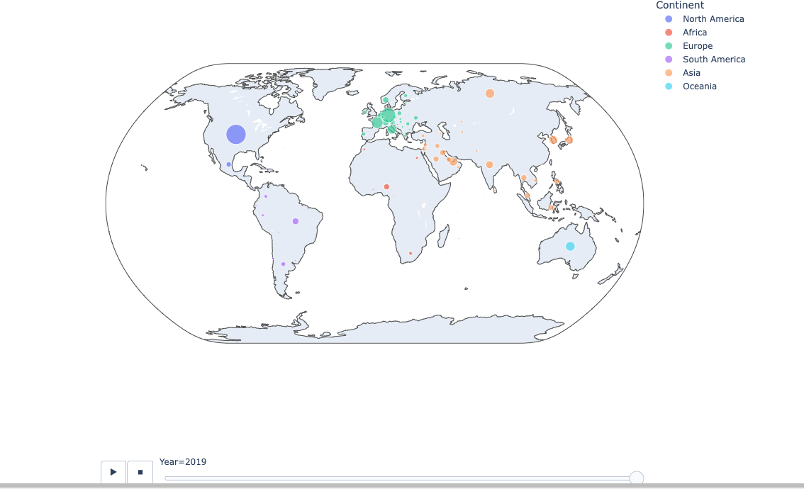

Slide 16
Data Analysis & Discussion
Tourism Analysis
Which continents are the most traveled to?
We created a pie-chart that displayed the percentages of travel to each continent.
The pie chart shows that visitors travel most to Europe (38%), Asia (30.5%), and North America (20.1%).
The bar chart shows the progression throughout the year. There has generally been an increase each year from 1995 – 2019

Slide 17
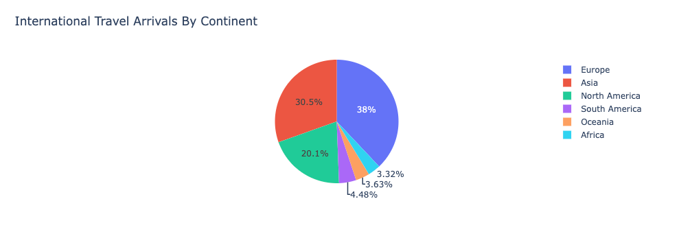
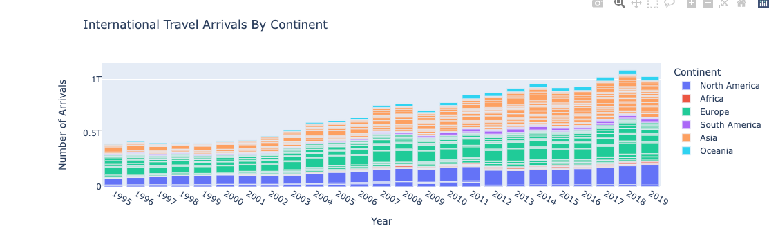

Slide 18
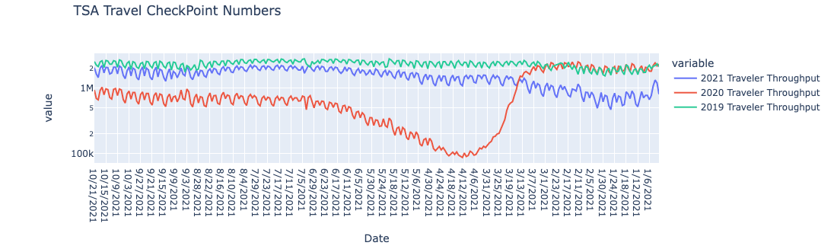
Data Analysis & Discussion
Tourism Analysis
How did COVID-19 affect the rate of travel in the USA?
A line chart was suitable for showing this data retrieved from the TSA website.
When compared to 2019 and 2021 data, the line for 2020 showed a significant decrease.

Slide 19
Data Analysis & Discussion
COVID-19 Restrictions
How has COVID-19 affected international travel from the United States?
As a result of COVID-19, travel to international countries was categorized as either fully Open, Open with restrictions, or Closed. This is because international governments have enacted certain travel bans and restrictions depending on your country of origin.
An interactive map was the best method to visualize the data. The legend of the map helps show how COVID-19 has affected international travel and break up the countries into three categories and colors, "Open," "Open with restrictions," and "Closed."

Slide 20
Data Analysis & Discussion
COVID-19 Restrictions
What are some of these travel restrictions that have been implemented due to COVID-19?
Hovering over specific countries in the map will show current available data pertaining to individual country travel rules and restrictions in addition to vaccination percentages.
Currently, most countries are in the category "open with restrictions." These countries require either mandatory vaccinations, quarantines, and COVID-19 PCR or antigen tests. Additionally, depending on the host nation, mandated quarantines can last up to a week or more, making short vacations to these countries illogical.

Slide 21
(Plots)

Slide 22
Data Analysis & Discussion
Travel Planner
What are the flight options available for the client's intended destination?

Slide 23
Data Analysis & Discussion
Travel Planner
What is the hotel availability in the destination of interest?

Slide 24
Data Analysis & Discussion
Travel Planner
What are some of the hotel options? How do these compare to each other in price and quality?

Slide 25
Data Analysis & Discussion
Travel Planner
How can we compare hotel locations with other points of reference?

Slide 26
Post-Mortem
Challenges
Working with GeoPy for the first time and creating a for loop to print out countries that GeoPy did not recognize. These "countries" were regions and had to be deleted from the data frame.
What would we research next?
We would look into specific country data and identify more tourist visitations throughout the years with more time.
Look at the most traveled areas and for potential trends to show up and coming popular travel destinations.

Slide 27
Appendix
List of APIs Used
Mapbox
List of New Python Libraries used
GeoPy
Works Cited
Puns: https://viatravelers.com/travel-puns/
https://www.tsa.gov/coronavirus/passenger-throughput
https://data.worldbank.org/indicator/ST.INT.ARVL
(not required)

Slide 28

Questions?

